Slide 2
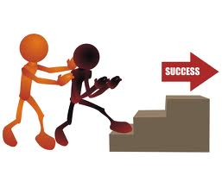
NEW TRENDS IN ENGLISH LANGUAGE TEACHING
PEARSON ALWAYS LEARNING
HOW TO MAKE IT SIMPLE AND PRODUCTIVE

Slide 3
TOPICS
PEARSON ALWAYS LEARNING
1. Why is it important to be up-to –date and how can new technologies help you to motivate your students , save your time and repetitive work at the same time.
2.MyEnglishLab – nothing is more interesting than doing the homework.
3. Active teach – an invention that has changed the world of teaching.

Slide 4
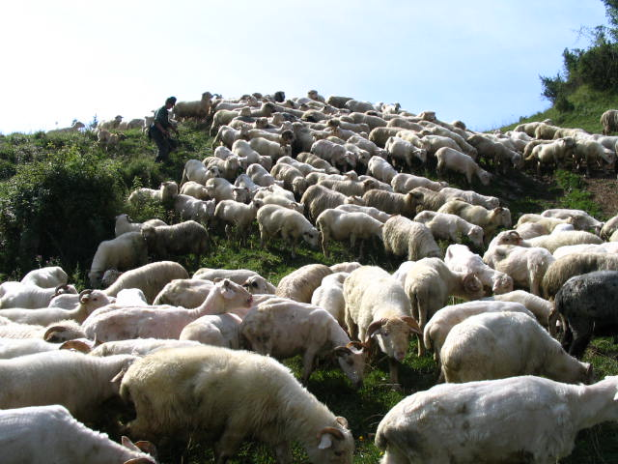
Teacher’s job
Notes:
What should we do:
Teach the language
Prepare for exams
Educate
Prepare for life
Help them develop as people
Discover their talents

Slide 5

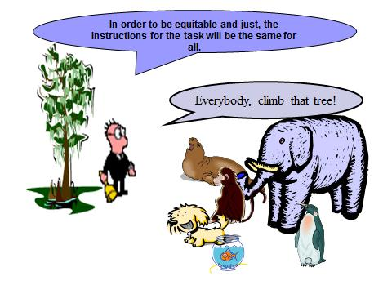
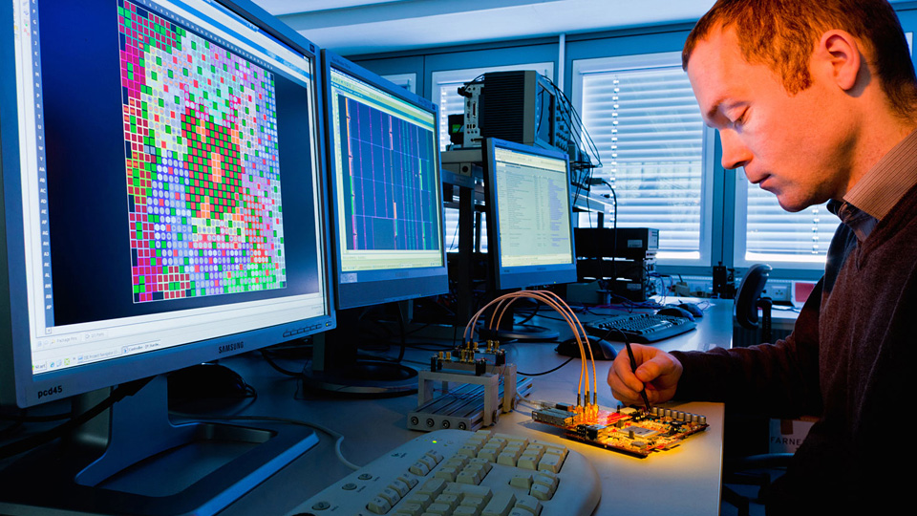

ADITIONAL VARIABLES
PEARSON ALWAYS LEARNING
Mixed level /ability
Learners autonomy
21st century skills
Technology
.................

Slide 6
PEARSON ALWAYS LEARNING
„Technology will not replace teachers......
Teachers who use technology will probably replace those who do not.“
Ray Clifford

Slide 7
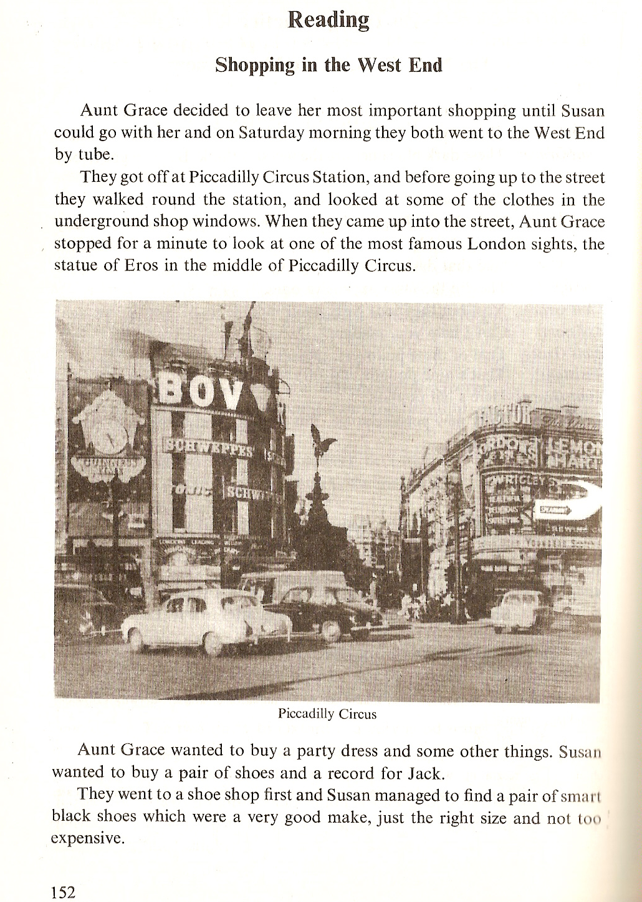

Notes:
Some autobiaghrafical comments on what being a teacher before 1990 involved – lack of modern coursebooks, impossible to teach from the coursebook

Slide 8
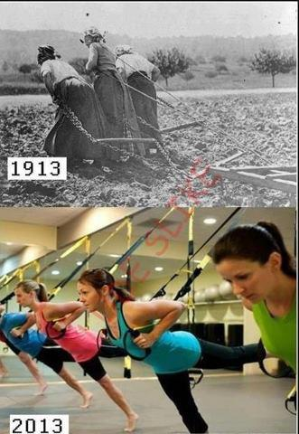
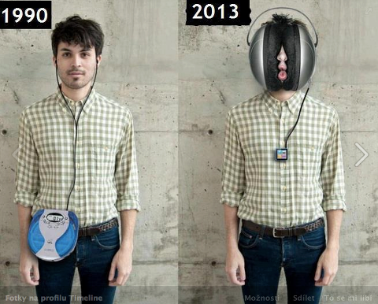

Slide 9
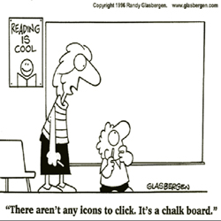
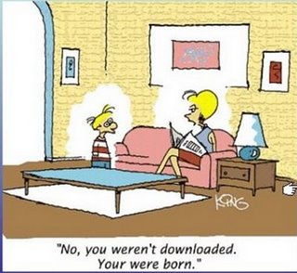
Student of the XXI century
„Digital Native” or „Digital Immigrant”?

Slide 10
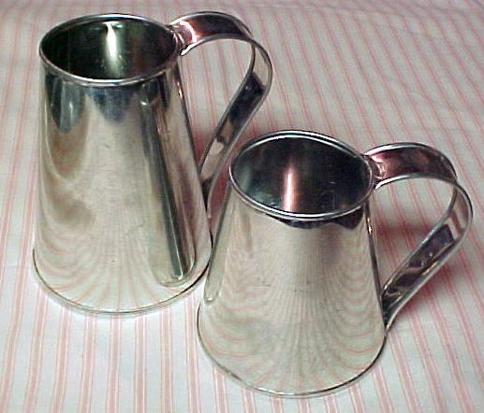
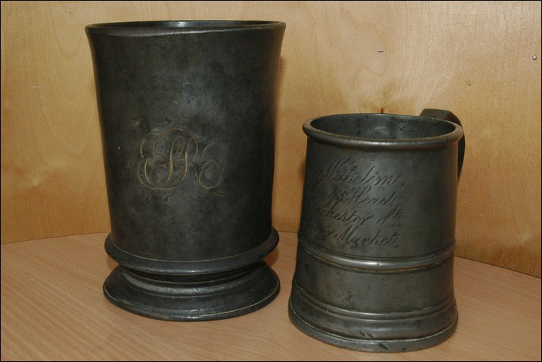
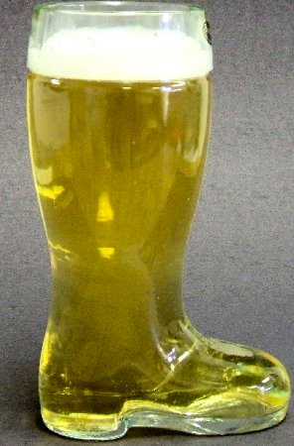

A problem – ‘A quart into a pint pot’
(or a litre into half a litre!)
PEARSON ALWAYS LEARNING
Curriculum demands
curriculum capacity
But! don’t waste good beer!

Slide 11

MyEnglishLab
PEARSON ALWAYS LEARNING
Notes:
Adrıan
Introduce ourselves

Slide 12
How much time do your students spend
DOING HOMEWORK?
PEARSON ALWAYS LEARNING

Slide 13

Do they enjoy it?
PEARSON ALWAYS LEARNING

Slide 14


Do they enjoy it?
PEARSON ALWAYS LEARNING
Or would they rather do something completely different?

Slide 15

Imagine..
PEARSON ALWAYS LEARNING
Individualization of homework with no additional work to it
Exercises which are automatically checked within few seconds
Possibility of sending additional writing assignments and tests
Gradebook with results and work of each student easily accesible

Slide 16

What does a student need?
PEARSON ALWAYS LEARNING
Computer (at home, in a library)
Internet connection
Group PIN number
Access Code for a particular title and level purchased together with a Student’s Book

Slide 17

What’s in it for the teacher?
PEARSON ALWAYS LEARNING

Slide 18

What’s in it for the teacher?
PEARSON ALWAYS LEARNING
„With MyEnglishLab we have more
time for the most important part
of teaching which is interacting
with our students.”
„Students are eager to do their
homework and even some extra tasks,
because they receive results
immediately.”
„MyEnglishLab makes the students
work systematically and they have
every single homework checked☺”
„I love MyEnglishLab! I don’t waste
time during the lesson for checking
homework.”
„It is a valuable support for the teacher.
I finally don’t have to carry all those
books home for checking. And it has
such an intuitive navigation system.”

Slide 19
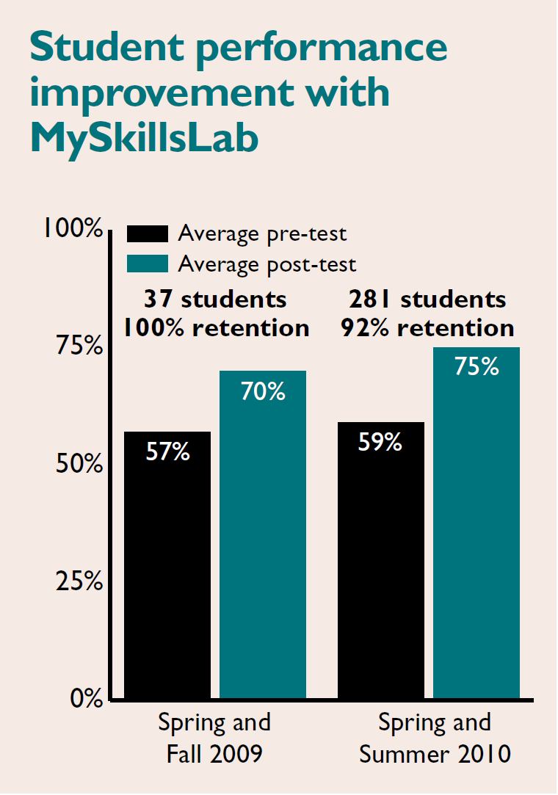
Notes:
San Diego City College

Slide 20
MyEnglishLab
PEARSON ALWAYS LEARNING
„MyEnglishLab is my and my students’ favourite component – It saves me a lot of time, and I can always rely on my students doing the exercises with more enthusiasm than in a regular paper workbook.“
(Zdena Machačová)
„I have found MyEnglishLab absolutely fantastic. My students simply love it. At the very beginning we experienced some problems, my students had to get used to the system of completing the exercises, choosing the right keys on their computers, etc. Nevertheless, once we really started, everything went smoothly.
(Zdena Machačová)
„Žáci jsou spokojeni, způsob procvičování se jim líbí. Výhrady mají jen k hodnocení „spellingových“ chyb, které jsou brány jako chyby gramatické.“ (Boháčová Iveta)

Slide 21
PEARSON ALWAYS LEARNING
2.Students complete the tasks at home
3.The grades are placed automatically in the student gradebook
4.The teacher checks the students’ grades
5.The teacher reviews homework in class
6.If necessary the teacher assigns tasks for individual students
1.Teacher assigns homework
How MyEnglishLab works

Slide 22




MyEnglishLab - Speakout
PEARSON ALWAYS LEARNING

Slide 23


MyEnglishLab - Choices
PEARSON ALWAYS LEARNING

Slide 24


MyEnglishLab - 2012
PEARSON ALWAYS LEARNING
Elementary
Pre-Intermediate
Intermediate
Upper-Intermediate
Intermediate
Upper-Intermediate
Elementary
Intermediate
Advanced
Notes:
Classic American English grammar course – Focus on Grammar in its 4th edition in 2012
And the new British English grammar course – MyGrammarLab

Slide 25



Questions & Answers
PEARSON ALWAYS LEARNING

Slide 26

PEARSON ALWAYS LEARNING
Questions please
Thank you!
Mgr.Danka Kecskésová, PhD.
danka.k@venturesbooks.com
Notes:
Thank you!

